Slide 1
Modular Programming(8-dars)
Davronbek Malikov

Slide 2



Bugun
Project 3 xolati va savol javob
Takrorlash
Log bn ishlash review
Pipeline in ML:
Data Loading
Data Preprocessing
Manual Preprocessingda muammolar
Auto Pipeline
Auto Pipeline: Amaliy
Vazifa

Slide 3
Project 3 xolati va savol javob

Slide 4
Takrorlash

Slide 5

Takrorlash
Project 3 xolati va savol javob
Takrorlash
Loading data using class
Pipeline
Pipeline: Amaliy
Vazifa

Slide 6
Log bn ishlash review

Slide 7
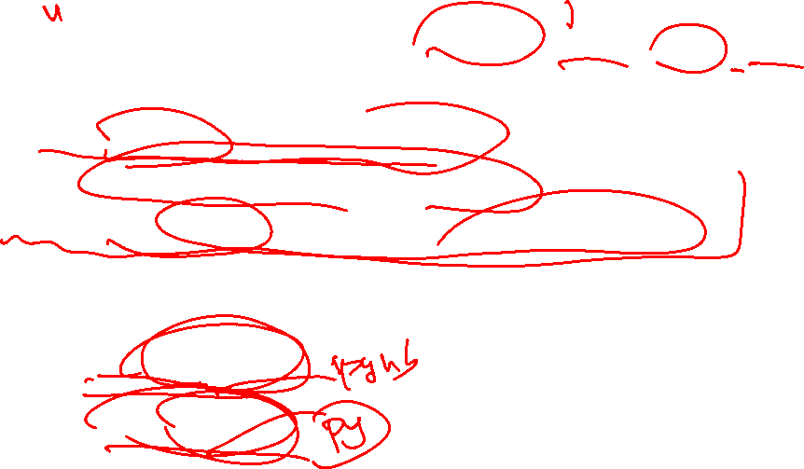

Log bn ishlash review
Qilinayotgan ishlar uchun xabarchi(boshi, oxiri , o’rtasi)
O’rganish, review qilish bosqichlari:
Oddiy log(python misol orqali)
Kichik datasetni yuklab ko’ring
O’sha dataset orqali biron ML task qiling
Classlarni import qiling:
src: class ichiga xam yozilishi/yozilmasligi mumkin
src->Notebook
src-> Scripts

Slide 8
Pipeline in ML

Slide 9
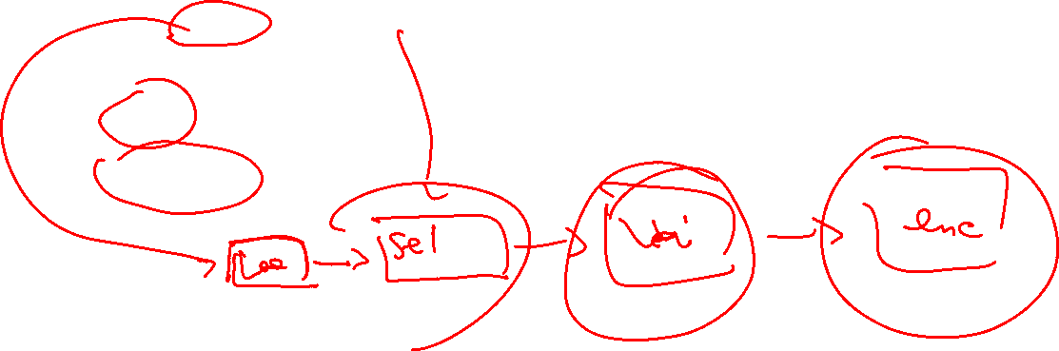
Pipeline in ML
Dastlabki qism:
Load Data
Data Preprocessing
Load_data->select_features->cleaning->encoding->
Xar bir qism(module) alohida va birgalikda xam manoga ega(ishlaydi)
Sodda
Murakkab

Slide 10
Pipeline in ML: Amaliy

Slide 11

Manual Preprocessingda muammolar

Slide 12
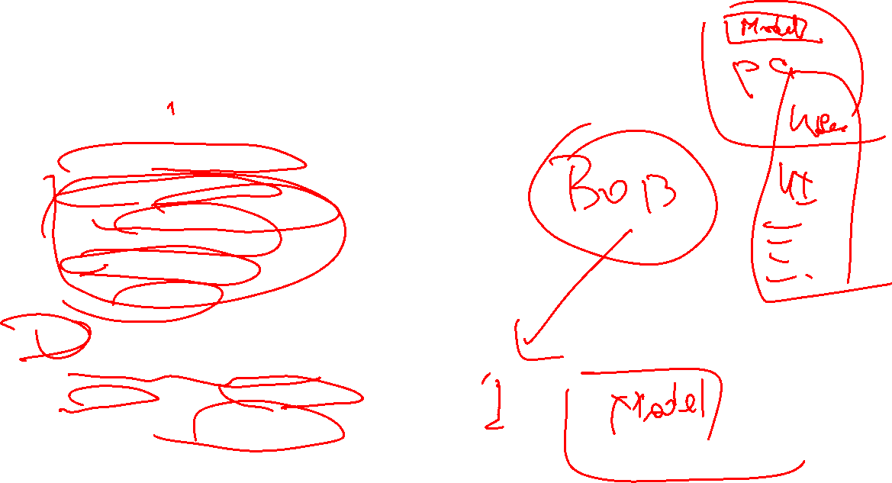
Manual Preprocessingda muammolar
Manual Pipeline Approach:
Multiple sequential steps
Handle missing values
Encode categorical features
Scale numeric features
Remove duplicates
Train the model
Issues:
Tedious for large datasets
Error-prone for new input data
Hard to deploy in production

Slide 13
Auto Pipeline
ColumnTransformer:
Barcha transformation avtomatik kechadi:
Numeric → Missing values,MinMaxScaler, StandardScaler
Categorical → Missing values, OneHotEncoder, LabelEncoder

Slide 14
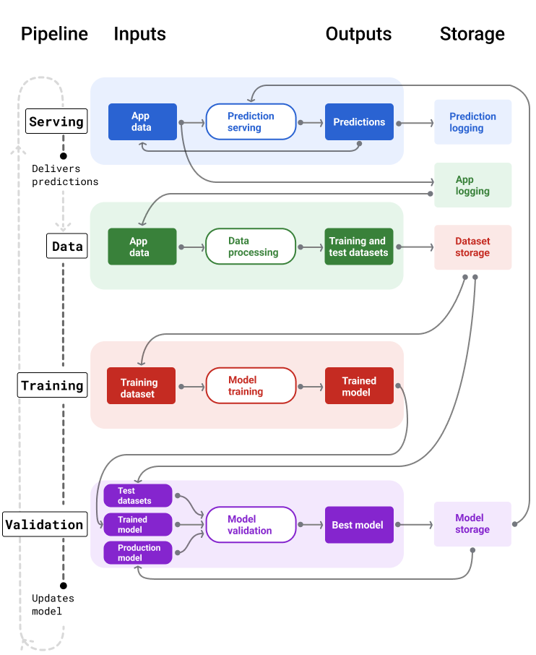
Auto Pipeline
ML: Pipeline

Slide 15
Auto Pipeline
Asosiy +:
Production-ready
Clean & maintainable
Automatic handling of new data inputs

Slide 16
Auto Pipeline
Asosiy componentlar:
ColumnTransformer– Turli xil ustunlarni birgalikda ketishini taminlaydi
Pipeline---Preprocessing + Algorithmni birlashtiradi
Automates workflow, reproducible, deployable

Slide 17
Auto Pipeline
Qo’shimcha componentlar:
OrdinalEncoder→LabelEncoder
handle_uknown:
Error
Ignore
(handle_unknown='use_encoded_value', unknown_value=-1)
One-hot encoder:
Handle_unknown=‘ignore’(nol)

Slide 18
Auto Pipeline
Asosiy +:
Production-ready
Clean & maintainable
Automatic handling of new data inputs
Automation: Users only provide raw input
Preprocessing is automatic.
Consistency: No risk of forgetting scaling or encoding steps.

Slide 19
Auto Pipeline: Amaliy

Slide 20
Vazifa

Slide 21
Vazifa
8-dars uchun Report yozing
Project 3 ni topshirishga tayyorlaning(classlarni import qilish orqali+Manual Pipeline+Log)
Log_review bolimida o’tilgan ketma ketlikda logni ishlating va alohida fileda yuklang

